Slide 1

Machine Learning Solutions for Optimizing Loan Application Approvals

Slide 2

A brief overview
The primary goal of this project is to predict loan approval outcomes using machine learning models. By leveraging advanced algorithms, we aim to accurately determine whether a loan application will be approved or rejected based on various applicant and financial features. This approach not only aims to improve the efficiency of the loan approval process but also seeks to reduce the risk of human error and biases in decision-making.

Slide 3

The Dataset
For this project, we are using a dataset named loan_approval_dataset.csv. This dataset comprises a range of features related to loan applications, including: Loan ID: Unique identifier for each loan application.
Number of Dependents: Number of dependents the applicant has.
Education: Whether the applicant is a graduate or not.
Self-Employed: Whether the applicant is self-employed.
Income Annum: Annual income of the applicant.
Loan Amount: The amount of loan requested.
Loan Term: Duration of the loan in months.
CIBIL Score: Credit score of the applicant.
Residential Assets Value: Value of the applicant's residential assets.
Commercial Assets Value: Value of the applicant's commercial assets.
Luxury Assets Value: Value of the applicant's luxury assets.
Bank Asset Value: Value of the applicant's bank assets.
Loan Status: The target variable, indicating whether the loan was approved or rejected.

Slide 4
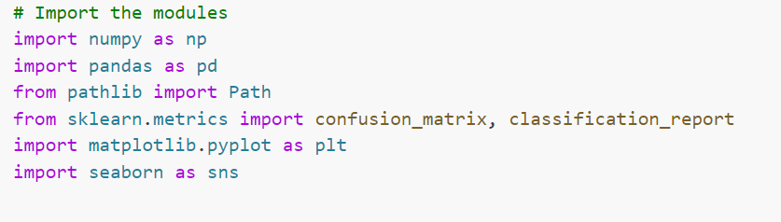
Data Preparation
To effectively handle and analyze the data, we need to use several powerful Python libraries. Here’s an overview of the libraries we imported and their roles in this project:
NumPy that provides support for arrays, matrices, and a wide range of mathematical functions to operate on these data structures.
Pandas we used Pandas to read the dataset, handle missing values, and perform exploratory data analysis
Pathlib It simplifies path manipulations
Scikit-learn This library is indispensable for machine learning. It provides simple and efficient tools for data mining and data analysis, including functions for model building, evaluation, and splitting the data into training and testing sets.
Matplotlib . It helps us visualize data distributions, model performance, and relationships between features.
Seaborn Built on top of Matplotlib, It's particularly useful for visualizing data distributions and correlations between features.

Slide 5
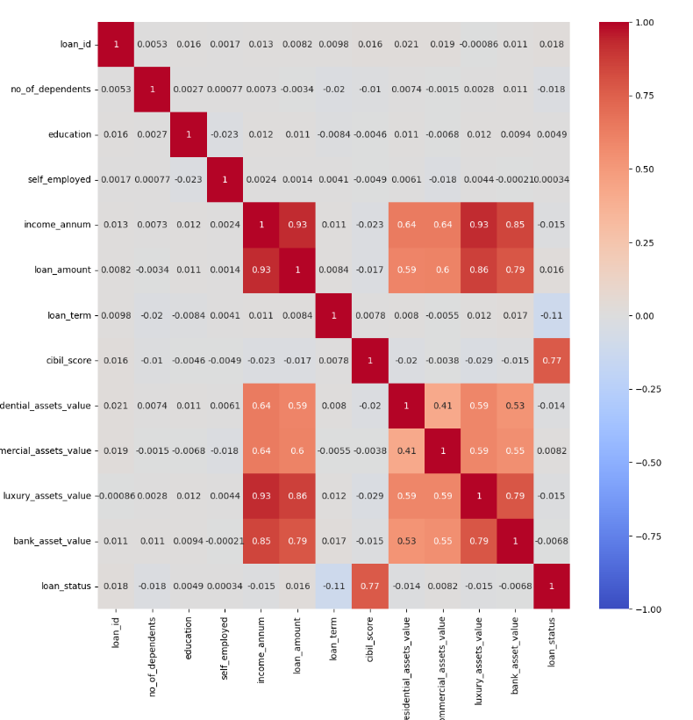
Data Visualization
To understand the relationships between different features in our dataset, we created a correlation heatmap using Seaborn. The heatmap visually represents the correlation matrix, which quantifies the linear relationships between pairs of features. The purpose of the correlation heatmap is to identify the strength and direction of the linear relationships between different features in our dataset. By observing the correlations, we can identify which features are strongly correlated with the target variable (loan_status). Strong correlations with the target variable suggest that these features are important predictors and should be included in the model.

Slide 6
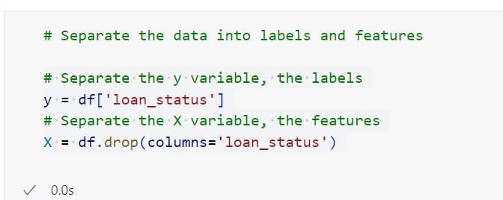
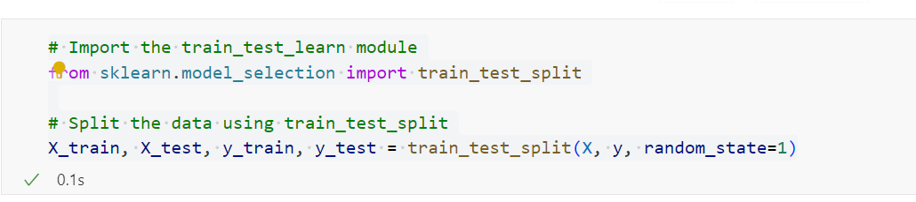
Data Splitting
Separating the label: loan_status from the features
Training the Model by using train_test_split to divide the data into training and testing sets.

Slide 7
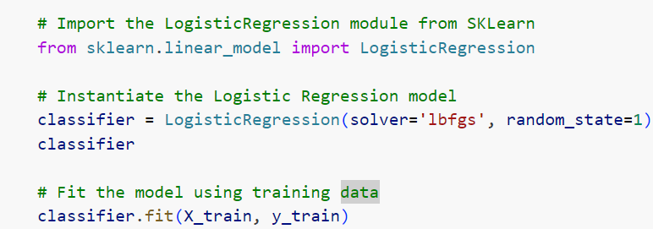
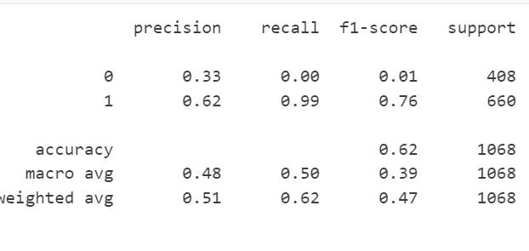
Model Training and Evaluation
Logistic Regression Model
For this model, we used the 'lbfgs' solver and set the random state to 1 to ensure reproducibility
Class 0 vs. Class 1: The model performed poorly on class 0, with very low precision and recall, indicating it struggled to correctly identify instances of class 0.
Accuracy: The overall accuracy was 62%, but this metric is less reliable due to class imbalance. The model predicted class 1 much more accurately than class 0.

Slide 8
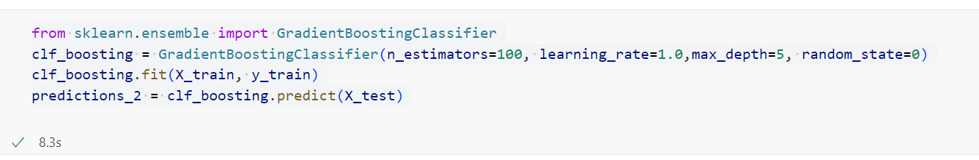
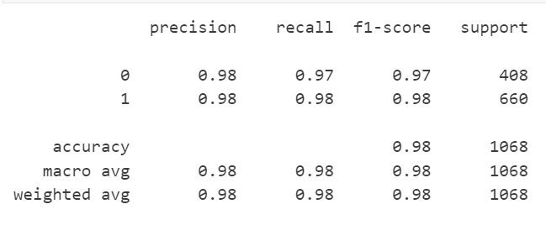
Model Training and Evaluation
Gradient Boosting
Is an ensemble method that builds trees sequentially, with each tree correcting the errors of the previous ones. This method aims to improve the overall model performance.
Precision, Recall, F1-Score: The Gradient Boosting model achieved very high metrics, with slight improvements in recall and F1-score over the Decision Tree and Random Forest models.
Accuracy: The model reached an accuracy of 98%, underscoring its strong performance in handling the classification task.

Slide 9
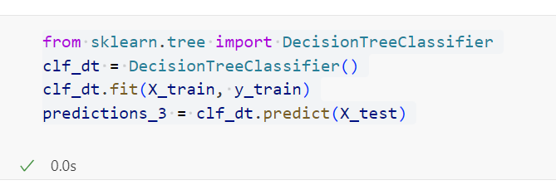
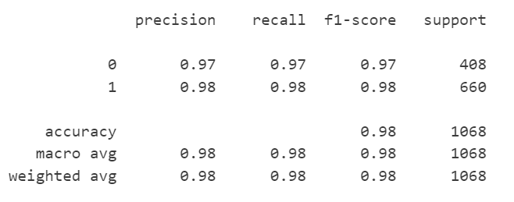
Model Training and Evaluation
Decision Tree
Decision Trees are non-linear models that split the data based on feature values. They recursively partition the data into subsets to make predictions.
We used the default parameters for the Decision Tree model.
Precision, Recall, F1-Score: The model showed high performance across all metrics, with values around 97-98%.
Accuracy: The accuracy was very high at 98%, indicating the model correctly classified the vast majority of instances.

Slide 10
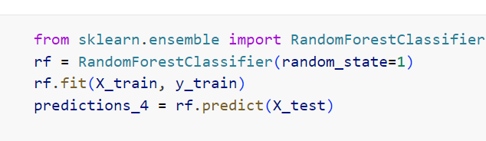
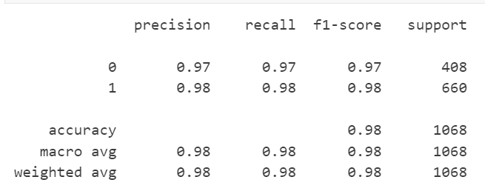
Model Training and Evaluation
Precision, Recall, F1-Score: The model demonstrated high performance metrics similar to the Decision Tree, with precision, recall, and F1-scores around 97-98%.
Accuracy: The accuracy was 98%, showing consistent and robust performance in classification tasks.
Random Forest
Random Forest is an ensemble method that combines multiple Decision Trees to improve the model's performance and reduce overfitting. We used the default parameters and set a random state for reproducibility.

Slide 11
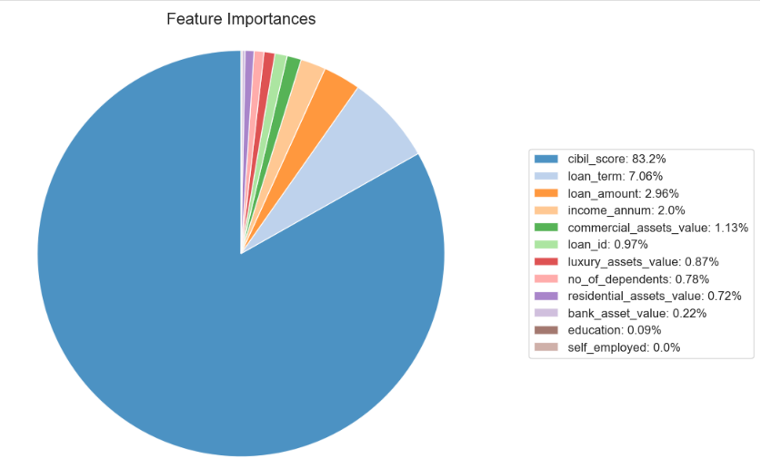
Model Optimization
To enhance the performance of our machine learning models, we undertook a feature selection process. This involved identifying and removing less important features that might not contribute significantly to the predictive power of our models. In this case, we decided to drop the education feature from our dataset. The rationale behind this decision was based on the correlation analysis and exploratory data analysis (EDA), which indicated that education had a relatively low correlation with the target variable (loan_status).

Slide 12
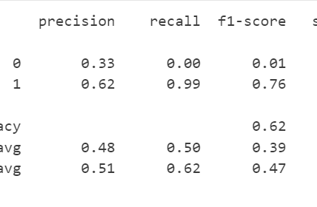
Model Optimization Retraining Models
After adjusting our feature set, we retrained our models to observe the impact of this optimization. Specifically, we focused on retraining the Logistic Regression and Gradient Boosting models, as they showed different levels of initial performance and could benefit from feature refinement.
Logistic Regression: The model's performance was not significantly affected by the removal of the education feature, maintaining an accuracy of around 62%. This suggests that the education feature was not a critical predictor for this model.
The Logistic Regression model's performance remained relatively unchanged. It continued to exhibit very low precision, indicating it struggled to correctly identify instances of class 0.

Slide 13
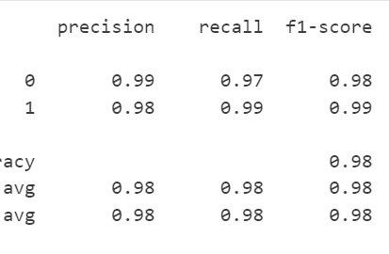
Model Optimization Retraining Models
The Gradient Boosting model continued to show high performance, indicating robust prediction capabilities. After feature reduction, it maintained a high accuracy of 98%, and the precision for class 0 (rejected loan) increased to 99%, demonstrating its robustness and ability to handle feature selection effectively.
In conclusion, optimizing feature selection can lead to more streamlined models without compromising performance, particularly for robust models like Gradient Boosting. This step enhances model efficiency and interpretability by focusing on the most relevant features.

Slide 14

Questions Time

Slide 15
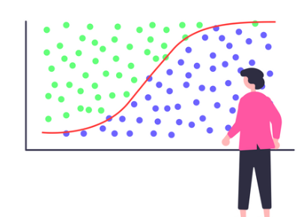
How well does the logistic regression model predict both the ‘1’ Approved and ‘0’ Rejected loan?
The logistic regression model is significantly biased towards predicting the 1 (Approved loan) label, with very poor performance in predicting the 0 (Rejected loan) label. The very low precision and recall for 0 indicate that the model rarely predicts a loan will be rejected and almost never correctly identifies a rejected loan. Conversely, the model has a high recall but only moderate precision for approved loans.
In summary, the logistic regression model is not well-balanced in predicting both labels. It tends to predict almost all loans as approved, which might be a consequence of an imbalanced dataset or insufficient feature representation. This bias can be addressed by techniques such as balancing the dataset, feature engineering, or using a more complex model as shown with Gradient Boosting or Decision Trees, which have demonstrated significantly better performance in our case.

Slide 16
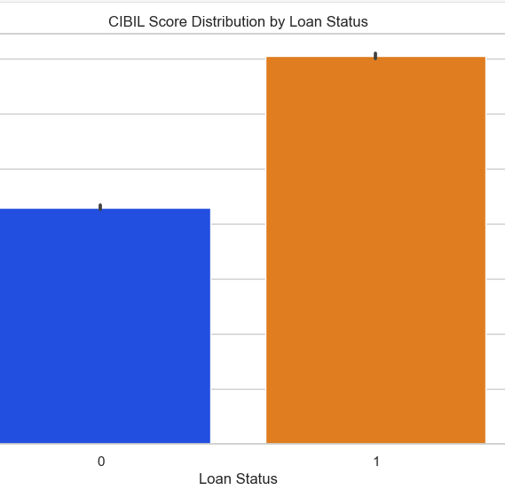
What are the most significant factors influencing approval decisions?
The CIBIL score is computed based on several factors, with repayment history contributing 35% of the score. Other factors include credit utilization, credit mix, and credit inquiries.Score is a three-digit numerical score ranging from 300 to 900 that represents an individual's creditworthiness Other important factors include loan term and various asset values .The CIBIL Score has the highest correlation with loan approval ,indicating its strong influence in the decision making process.

Slide 17

How well can machine learning predict loan approvals compared to traditional models?
Machine learning models often outperform traditional methods in predicting loan approvals due to their ability to capture complex patterns in data. Traditional methods for loan approval might rely on simple rules that fail to capture all the nuances present in the data. In contrast, machine learning models can analyze a wide range of features and their interactions, free from human bias or error. These models typically offer improved accuracy, precision, recall, flexibility, and automation compared to traditional methods.
Based on our results, the machine learning models, particularly the gradient boosting and decision tree classifiers, achieved high accuracy (around 98%), demonstrating their proficiency in predicting loan approvals.

Slide 18

Conclusion
The initial logistic regression model achieved an accuracy of 62% but struggled with precision and recall for "rejected" loans. In contrast, the Gradient Boosting Classifier significantly improved accuracy to 98%, demonstrating high precision and recall for both approved and rejected loans. Similarly, Decision Tree and Random Forest models also reached 98% accuracy, indicating their robustness with this dataset. These findings suggest that Gradient Boosting and Random Forest models can be reliable tools for predicting loan approvals, potentially reducing the risk of approving high-risk loans. Automating the loan approval process with these models can streamline operations, reduce manual workload, and speed up decision-making for financial institutions. Furthermore, these data-driven models can ensure consistent decision-making, potentially reducing biases present in manual approval processes.

Slide 19

In the Future
Future work should focus on feature engineering by introducing additional factors such as employment history, debt-to-income ratio, and previous loan history, and exploring interactions between existing features to capture more complex relationships. Hyperparameter tuning through methods like Grid Search or Random Search could further enhance model performance. Advanced models, including neural networks, should be tested for their ability to capture non-linear relationships, and ensemble methods should be explored to create a more robust predictive system. To improve model interpretability, SHAP values can be used to explain model predictions, ensuring stakeholders understand the decision-making process, and feature importance analysis can identify the most influential factors in loan approval decisions. By addressing these areas, the predictive accuracy and robustness of the models can be enhanced, leading to more reliable and effective loan approval systems in real-world applications.

